Slide 1

MAY 2023
CHEMICALS IN COSMETICS
Data Analytics: PROJECT 3
Paola Aleman
Maria Jose Garcia
Cesar Cruz
Marcela Maldonado

Slide 2


INTRODUCTION
The data that we have chosen to work with has been reported to the California State Cosmetics Program (CSCP) in the California Department of Public Health (CDPH).
The purpose of the CSPC is to collect information of products that contain any ingredients known or suspected to cause: cancer, birth defects, developmental or reproductive harm. There is a list of “reportable” ingredients in which the California Safe Cosmetics Act requires all the manufacturers, packers, and or distributors to submit if:
the company has an annual aggregate sale of cosmetic products of 1 million dollars or more and
has sold cosmetic products in California on or after January 2007.
Github Link
Notes:
majo

Slide 3
1
2
3
INDEX
4
5
Data Set
Project Development
HTML
Explains some of the variables included
The user friendly web page created
Describes workflow and issues encountered
Graphics
Conclusion
1.All companies reported
2.Top 10 companies reported
3.Primary categories by count
Data summary

Slide 4

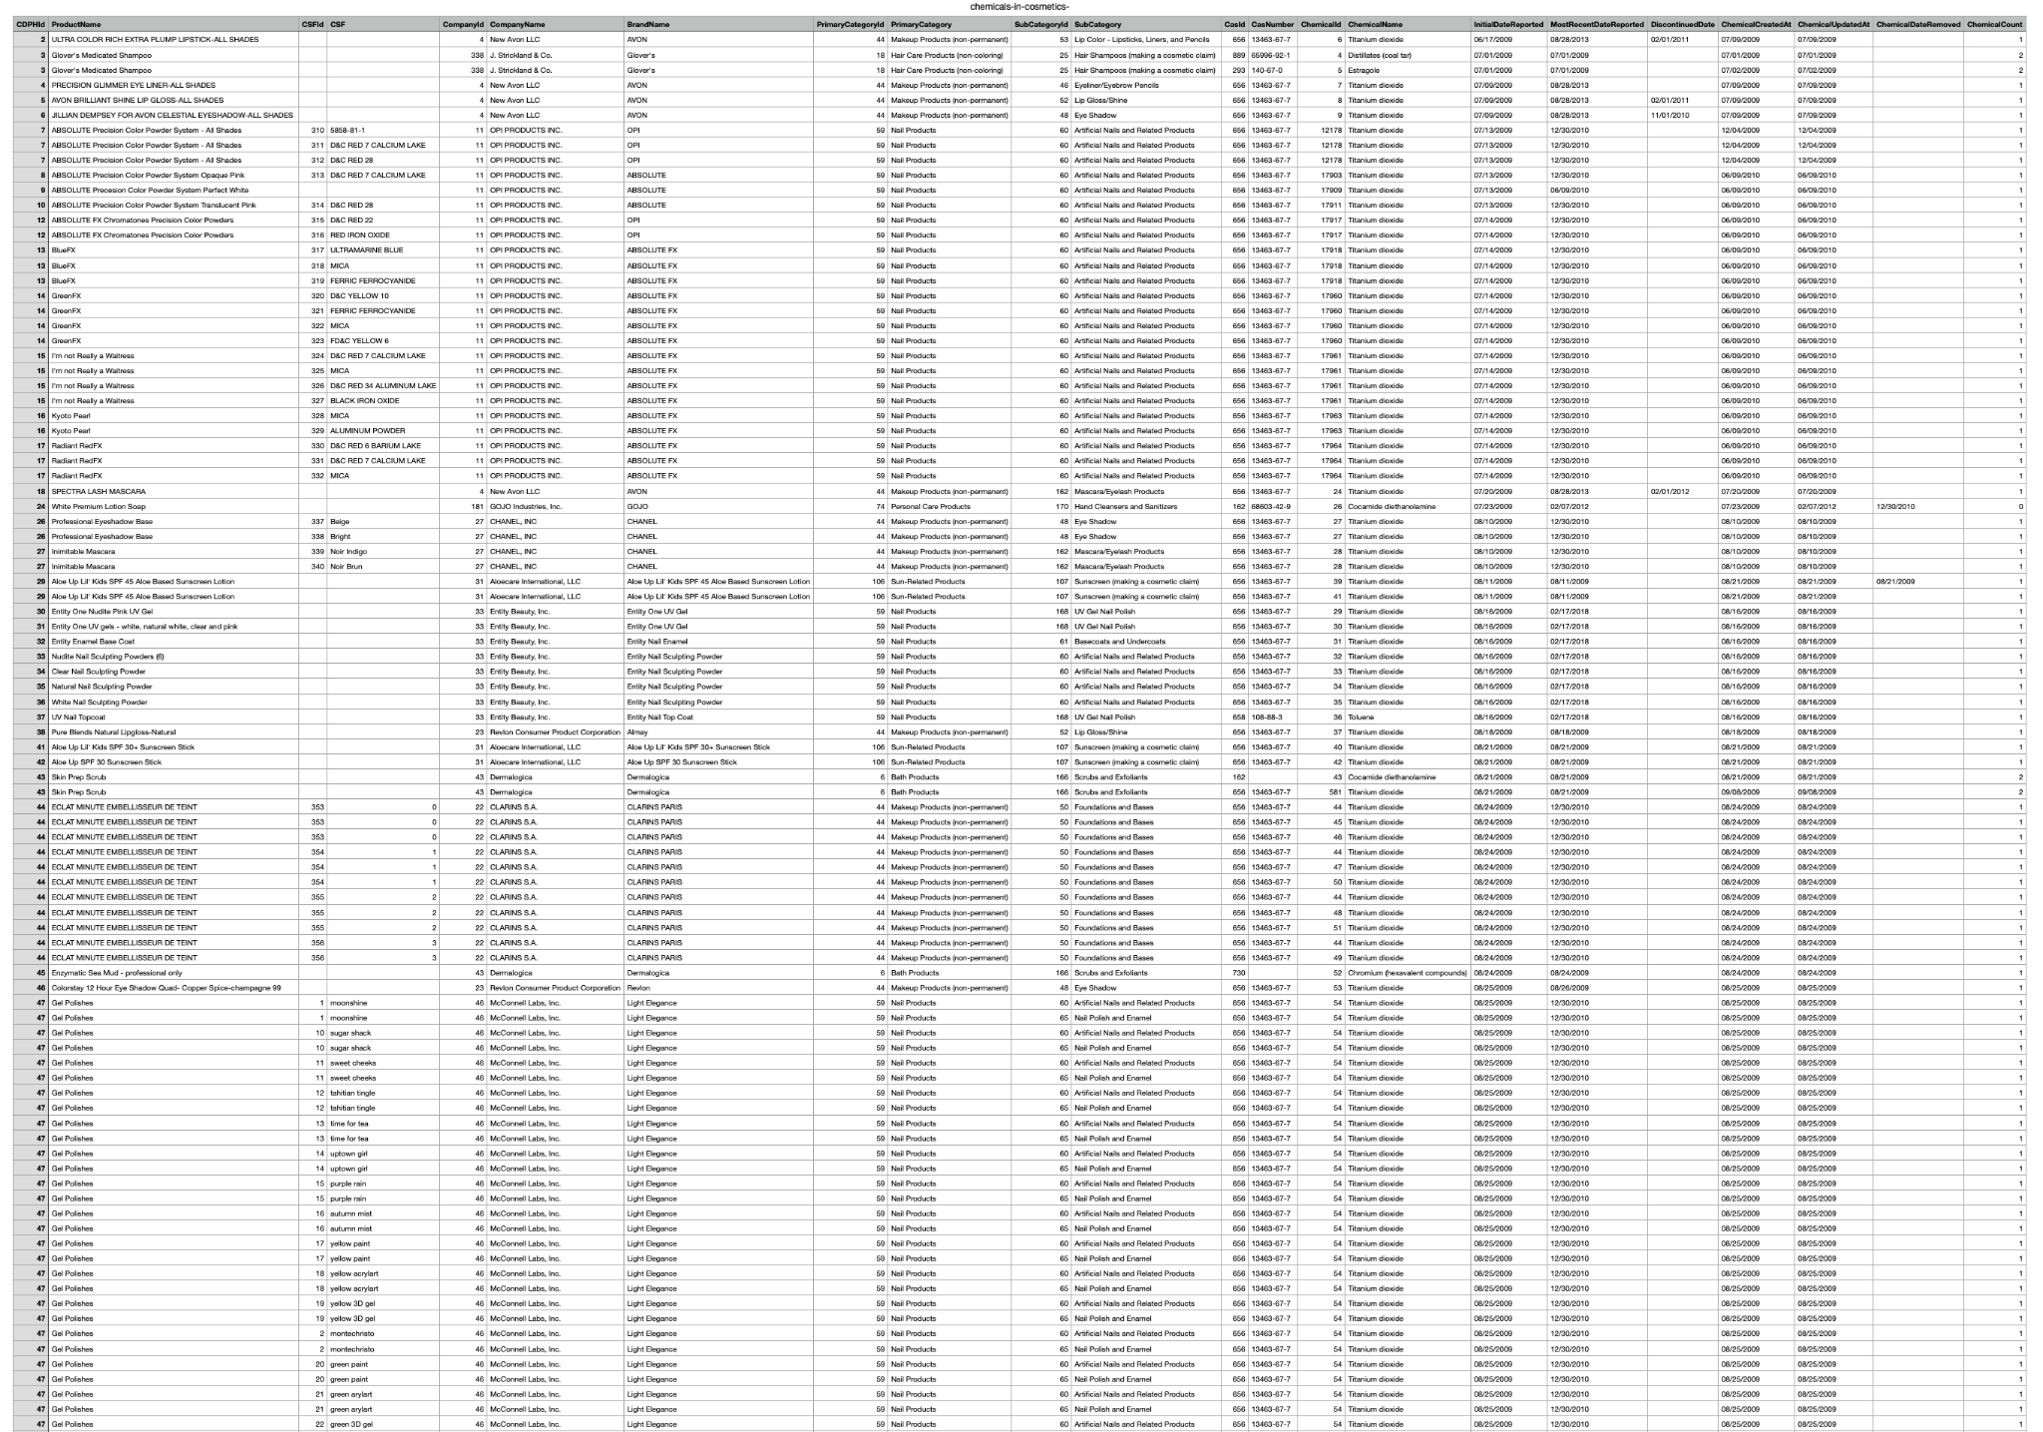
DATA SET
The data set includes 22 columns and 114,635 rows. To mention a few:
Primary product categories
Subcategories
Company names reported
Chemical names reported
Product Names
Dates Reported
We had out data in a csv file, which was uploaded to MongoDB. Using a flask we accessed this information for our html.
Notes:
majo

Slide 5
Project Development
Day 1: Found the database we wanted to work with and worked in our 1 page proposal.
Day 2: Cleaned Data using Python and uploaded our dataset to MongoDB.
Day 3: The flask,index and API were created. We also had an issue with CORS, since all of us had Mac we lost a whole day with this issue.
Solutions we tried to solve the CORS problem:
Using different computers
Uploading our dataset to Life Server
Day 4: Found a solution to our problem. We created the static and template folders. In the app.py we assigned the index to the render template and we used the localhost/index address to pull our dataset and overcome the CORS issue.
Day 5: We started pulling the information from the flask so we could show the graphs and making the html look a little nicer.
Day 6: Got the powerpoint presentation ready and final details.
Notes:
Cesar

Slide 6
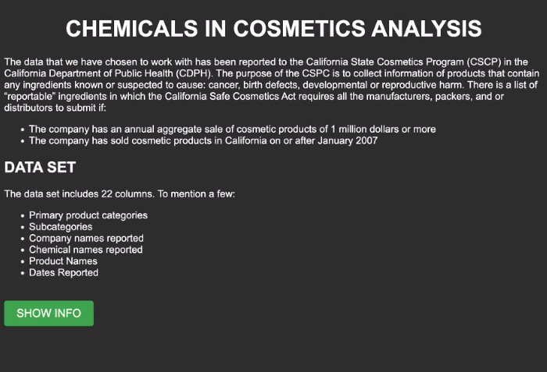
HTML
User driven interaction we included is a button which shows the info
Notes:
cesar

Slide 7
GRAPHICS

Slide 8
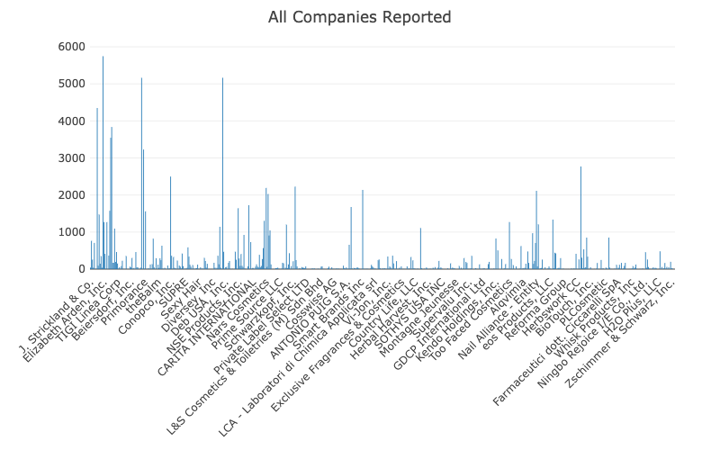
All Companies Reported
Bar chart
Notes:
marce

Slide 9
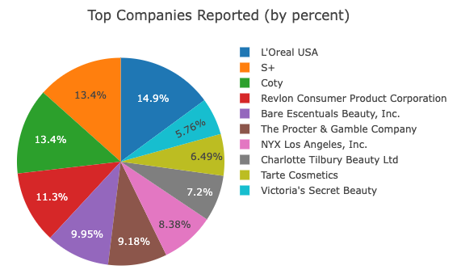
Top 10 Companies Reported
Pie chart
Notes:
marce

Slide 10
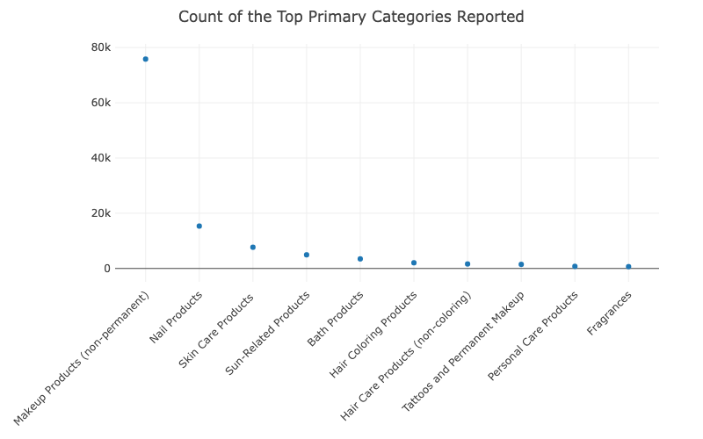
Primary Categories Reported by Count
Bubble chart
Notes:
marce

Slide 11

Conclusions
Project
All the team members own a Mac so we had a lot of trouble working with the flask.
We also came to the conclusion that working with Java is not very easy and needs practice to dominate and feel more confident .
It is complicated working with a big database (100MG) .
Notes:
pao

Slide 12
Conclusions
Database
Out of the 44 companies reported, the top 3 were L'Oreal Paris USA, S+ and Coty.
Out of the 13 primary categories, the top 3 were make up products, nail products and skin care products; however the amount of makeup products reported is very high compared to the other ones (with more than 70k+).
In the scatter plot chart, most of the categories reported (8) have less than 10k products reported.
Notes:
pao

Slide 13

THANKS!
Do you have any questions?

